Slide 1


Study the Growth of Cryptocurrency and Predict its Future
Team Members
Jaishaanth Suresh – Data Preparation (Web Scraping) and Future Prediction
Anish Adhikari – Data Collection and Preparation (API)
Gayathri Gnanam – Deep Analysis and Data Analysis
Mahesha Sree Sivasubramaniam – Data Visualization

Slide 2
Problem Statement
Analyzing and Visualizing Historical Price Trends
Predictive Models for Future Price Movements
KPI
Exploring top 5 coins – High Volatile & Low Volatile
Deep Analysis using Support Vector Regression
Experimenting with Moving Average Prediction Models

Slide 3
What is Crytocurrency?
Cryptocurrency is decentralized digital money designed to be used over the Internet
They are encrypted using encryption algorithms like SHA-256

Slide 4


Crypto Exchanges and Wallets
A cryptocurrency exchange is a digital marketplace that enables users to buy and sell cryptocurrencies
A crypto wallet is a small device or piece of software that allows the owner to manage their funds on the blockchain.

Slide 5


Slide 6
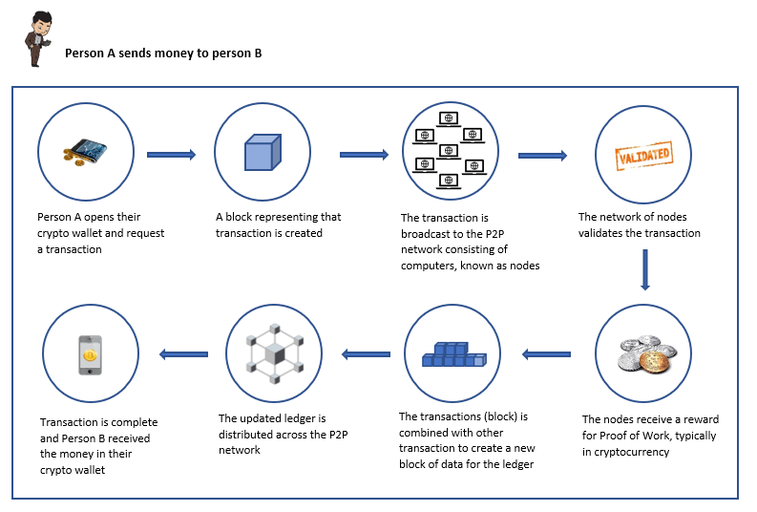

Slide 7

Data Sources
CoinMarketCap
CoinGecko
CryptoCompare
Binance

Slide 8
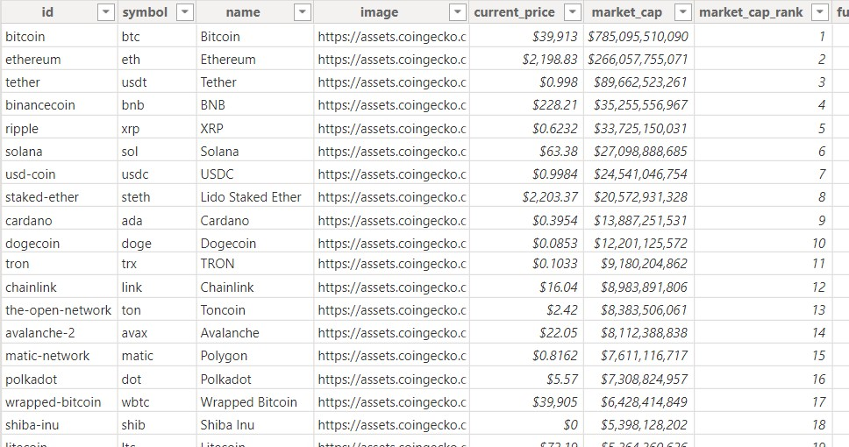
Data Collection
Web Scraping using Python
API

Slide 9

Data Preparation
Data Cleaning – Missing Values
Data Transformation – Formatting the columns
Feature Engineering – Added Date Table

Slide 10
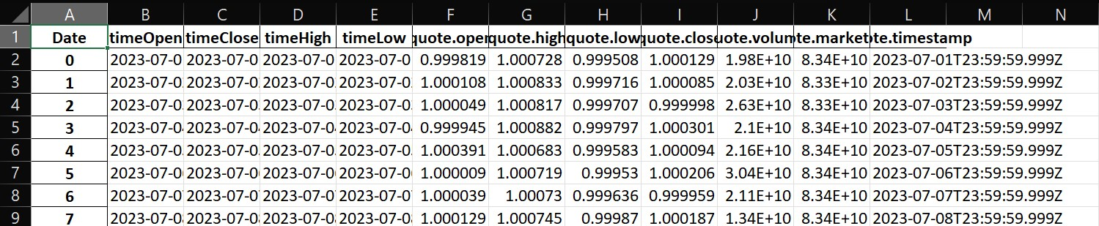
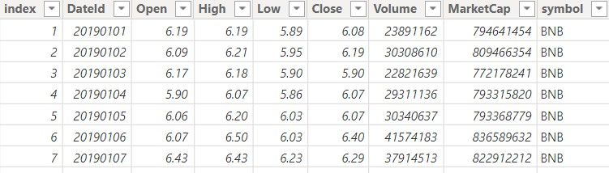
Uncleaned and Cleaned Data

Slide 11
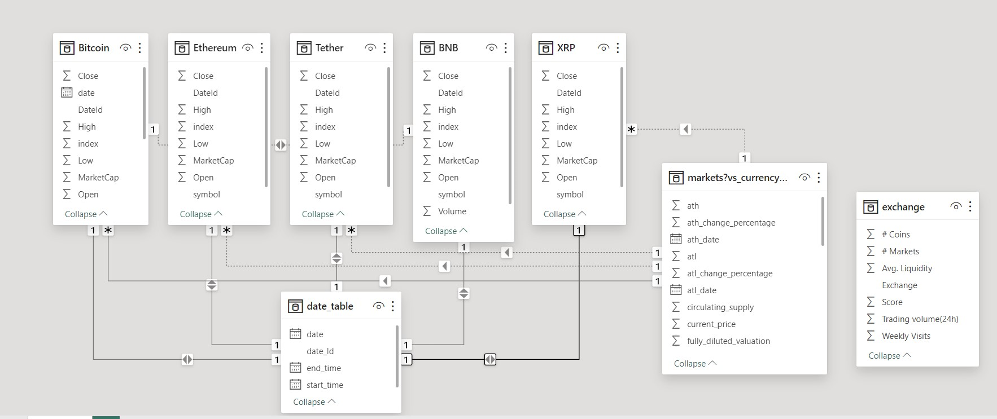
Data Modeling

Slide 12
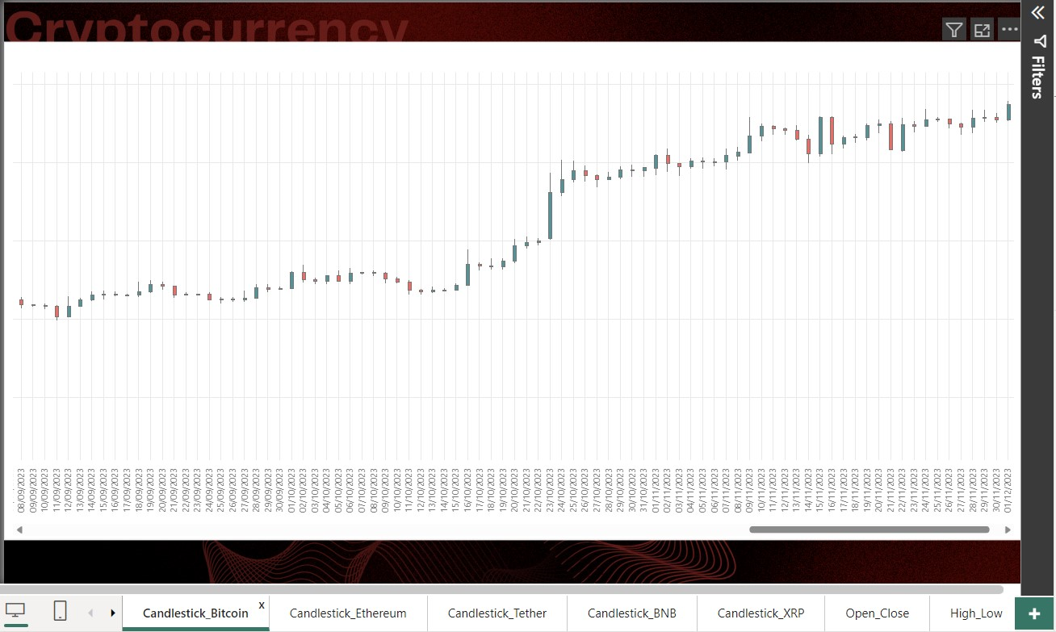
Data Visualization

Slide 13
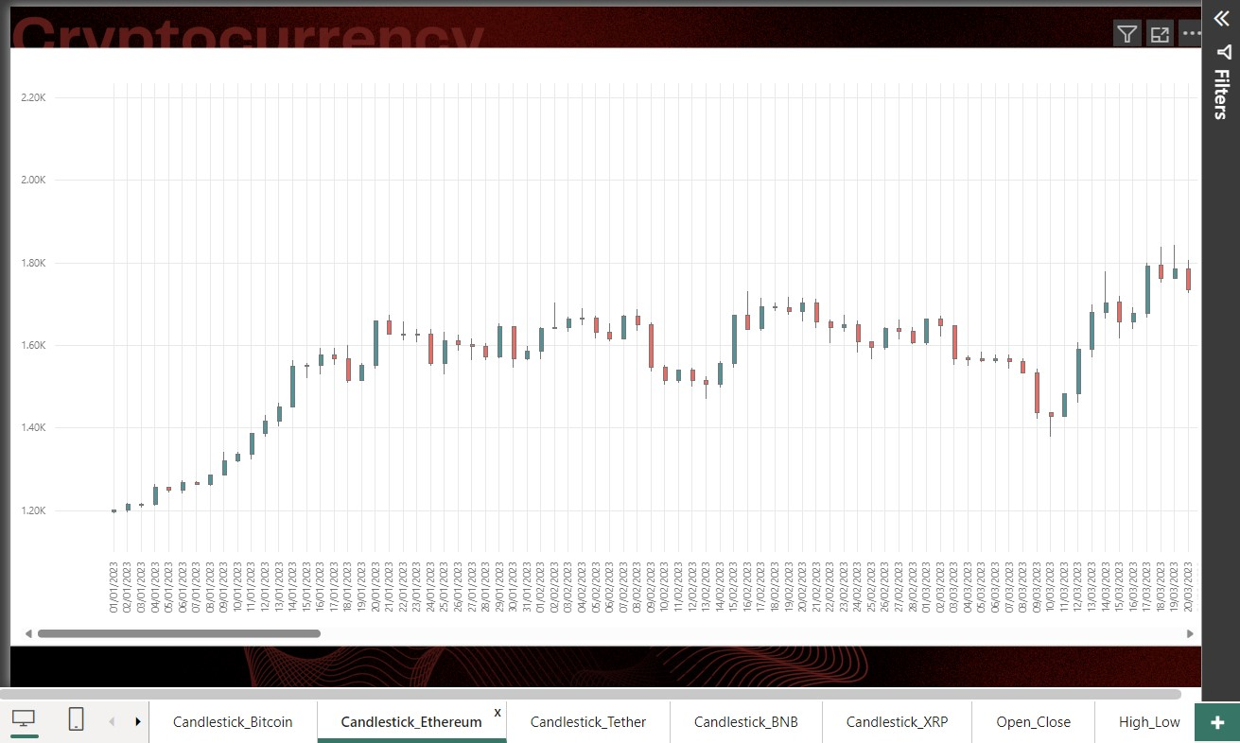

Slide 14
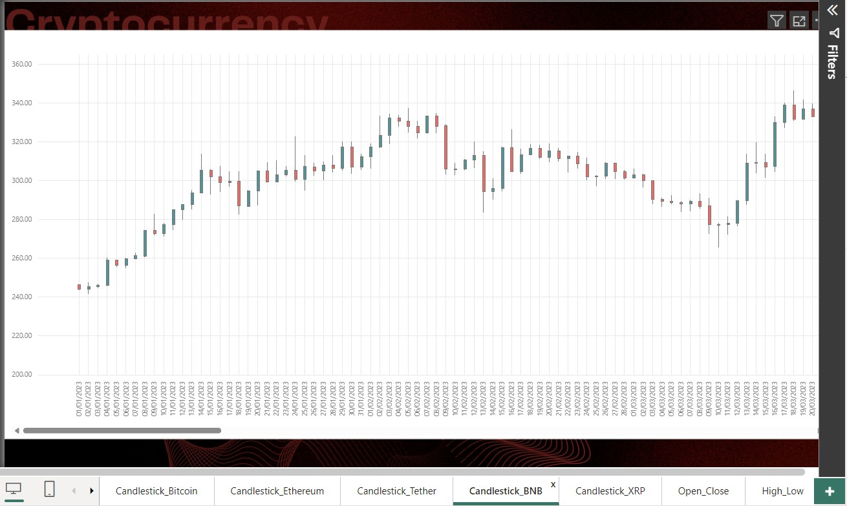

Slide 15
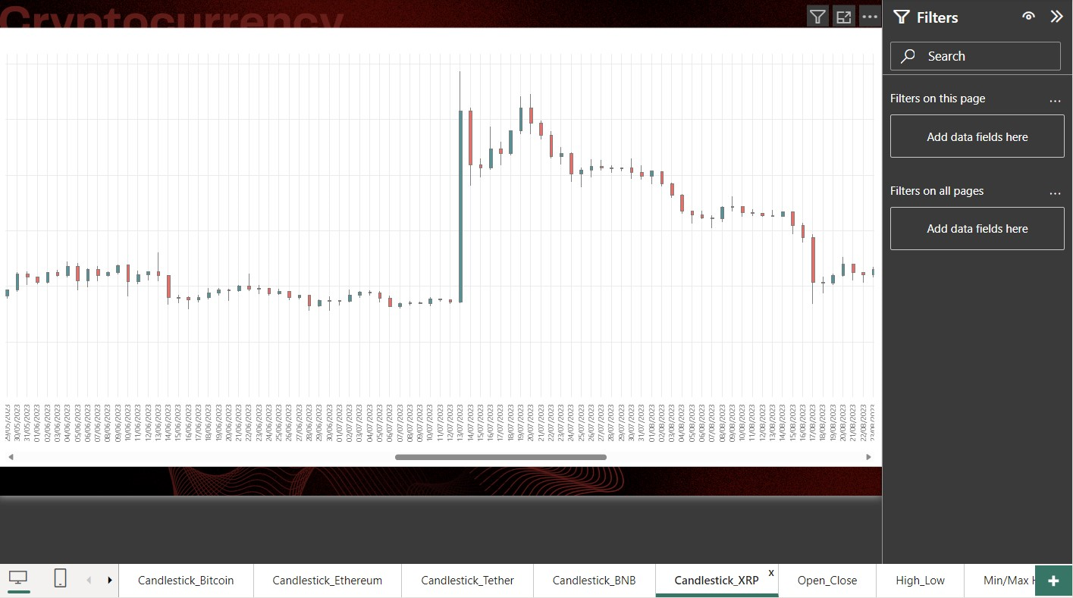

Slide 16
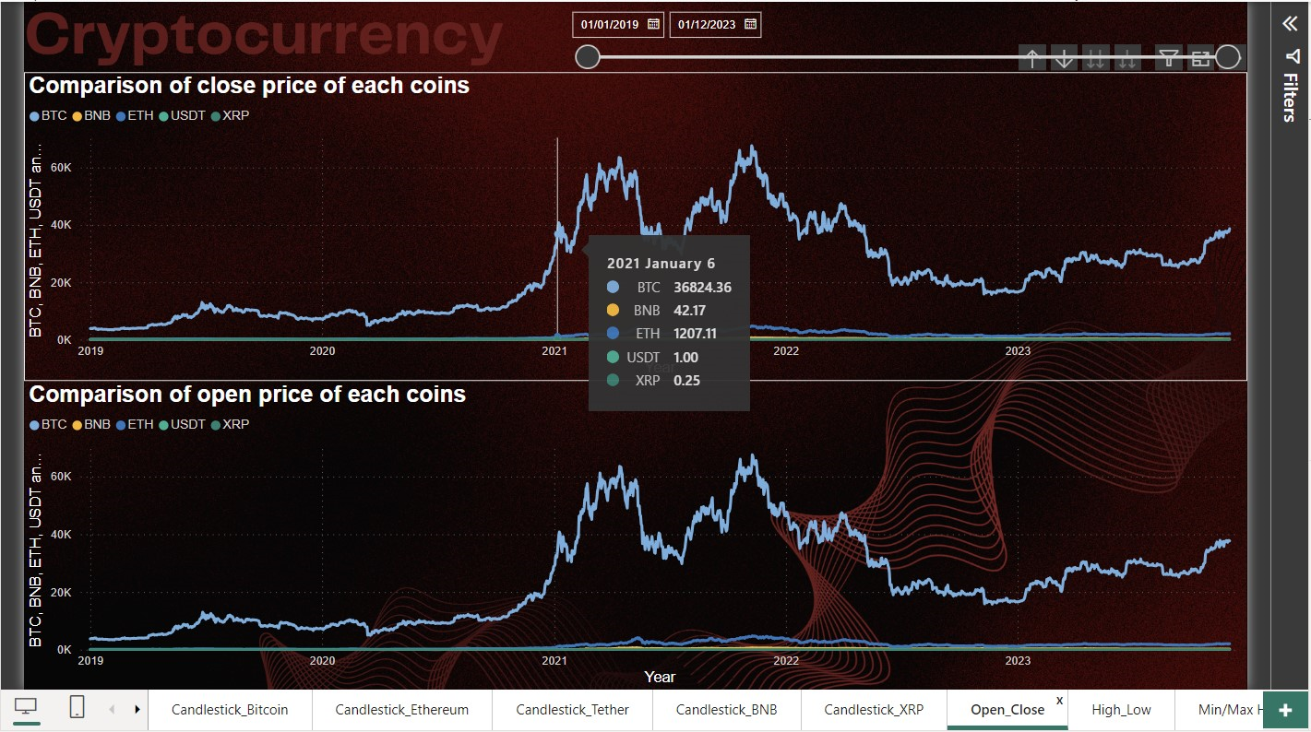

Slide 17
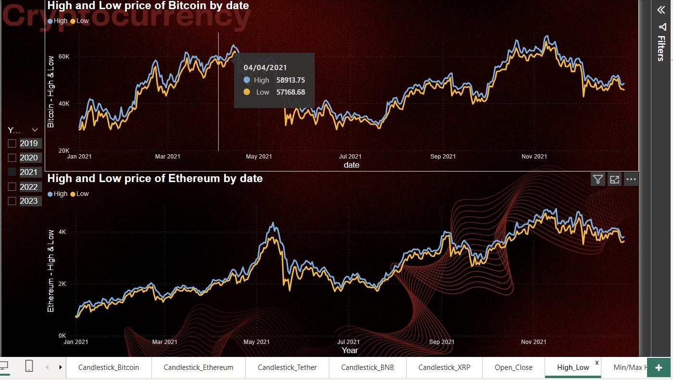

Slide 18
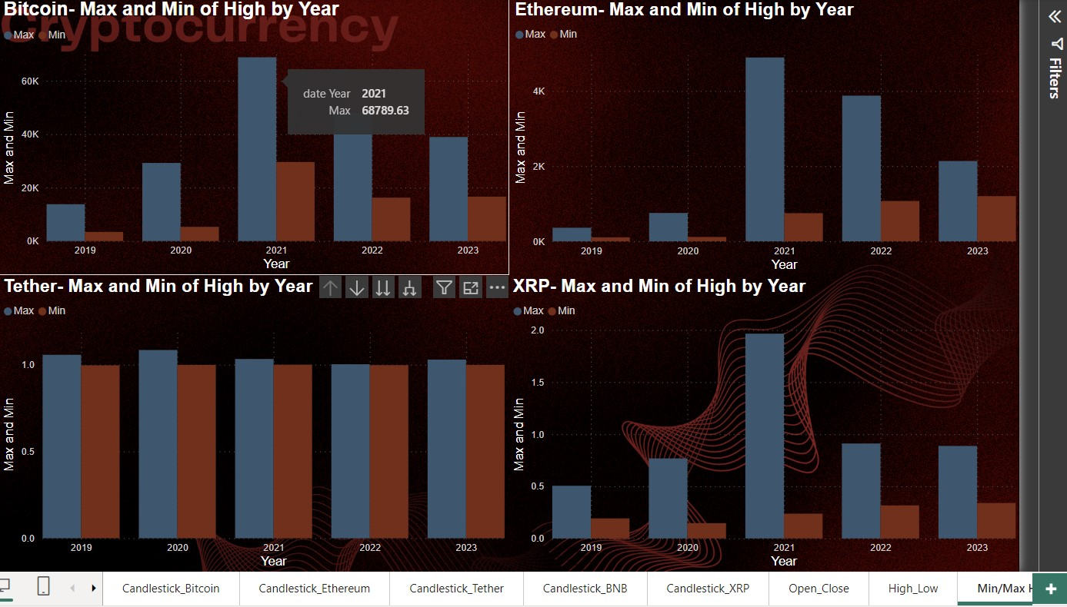

Slide 19
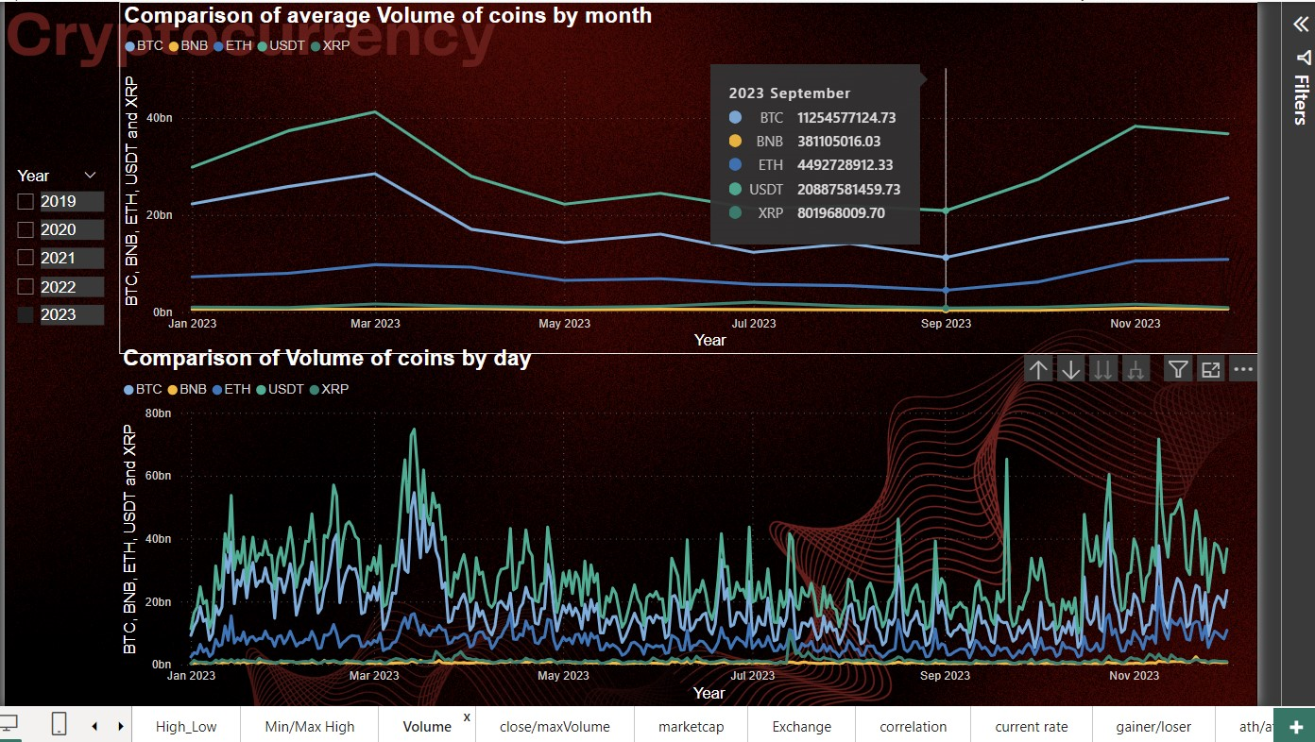

Slide 20
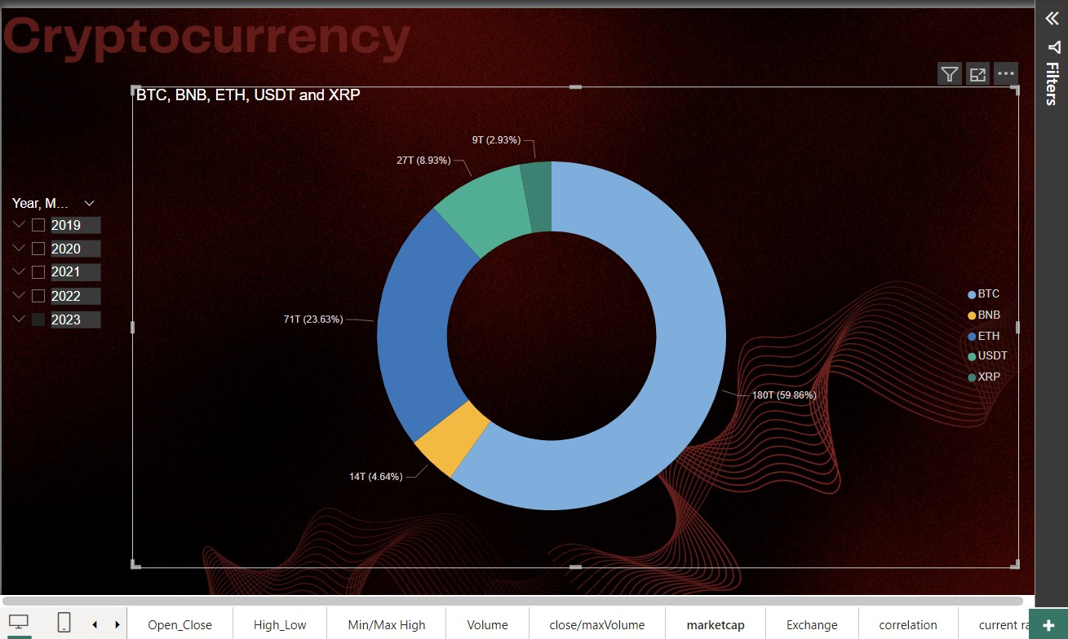

Slide 21
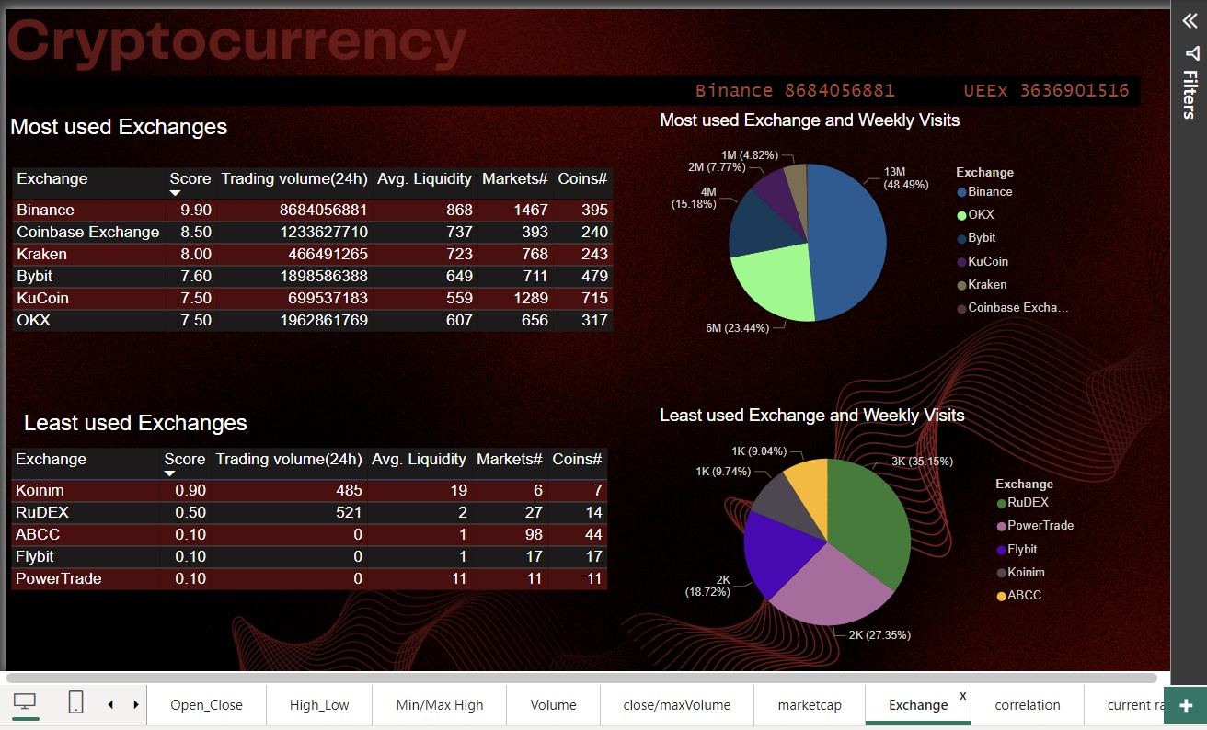

Slide 22
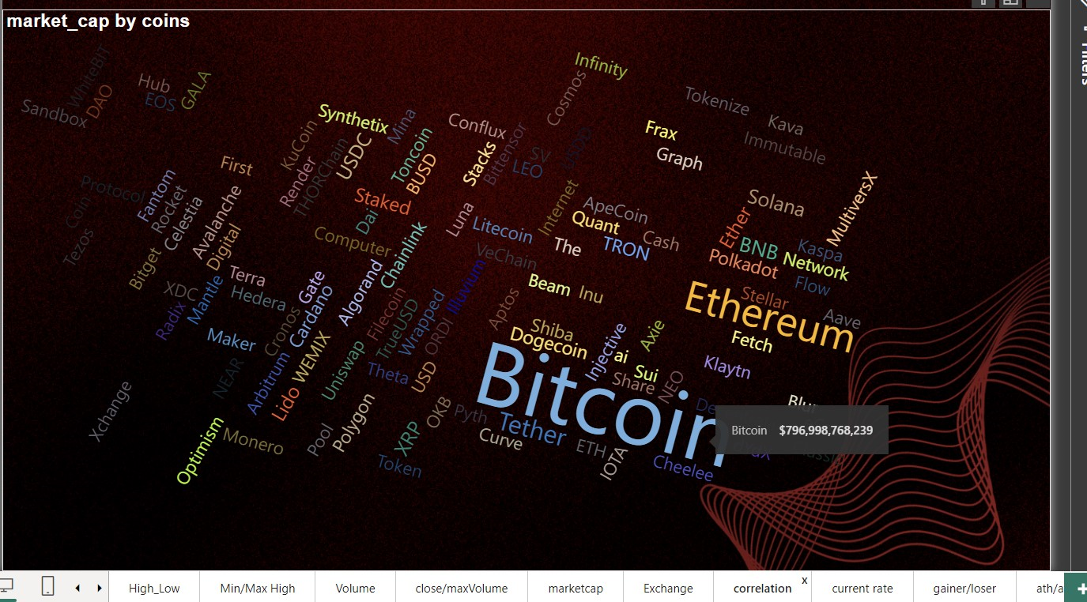

Slide 23
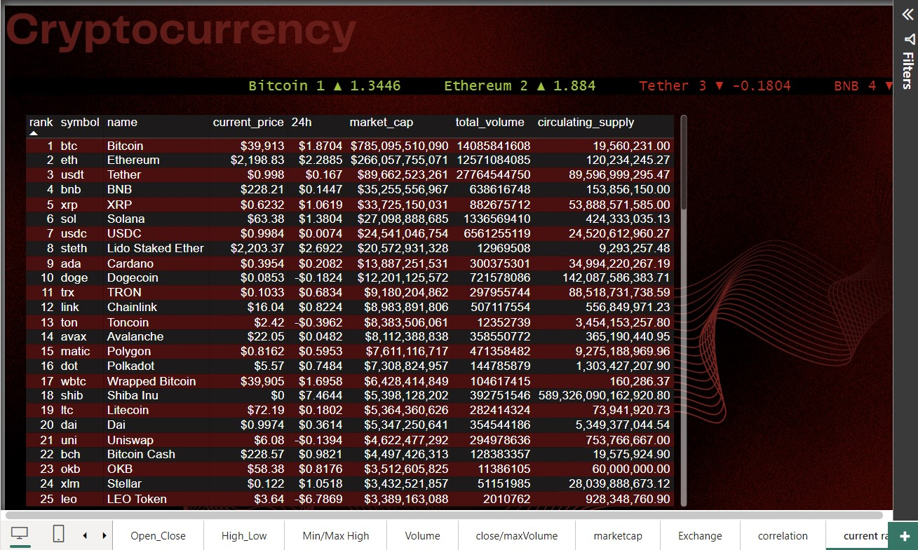

Slide 24
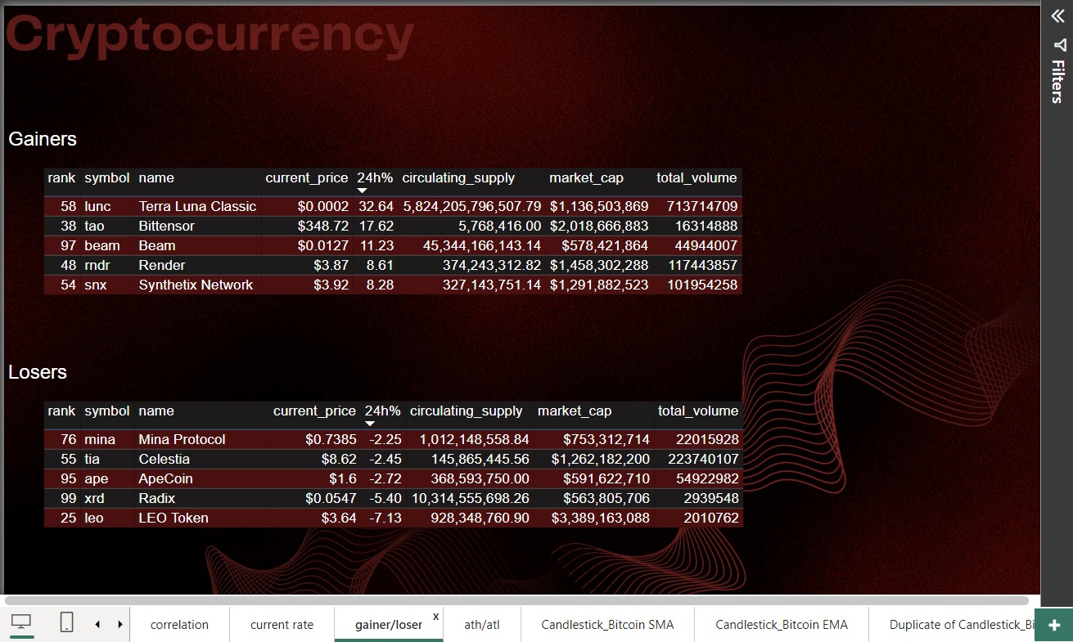

Slide 25
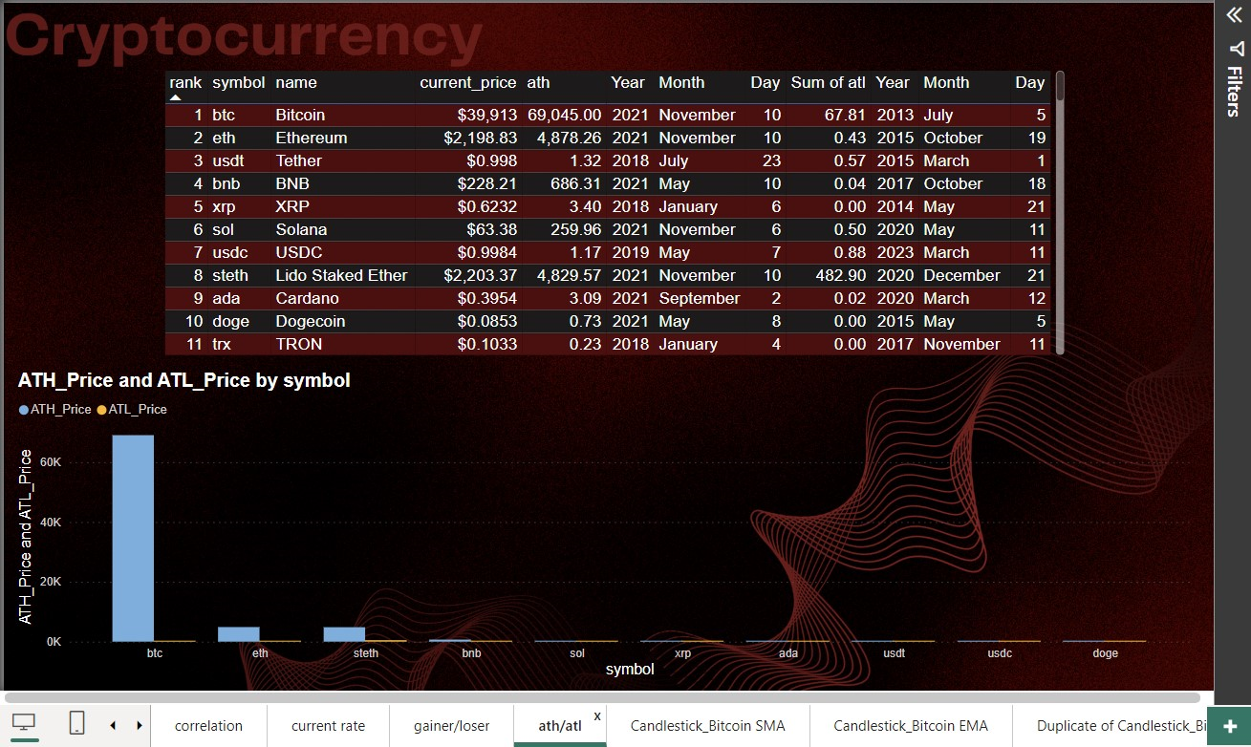

Slide 26
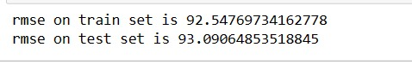
Predictive Modeling using Linear Regression
Root Mean Squared Error: 93%
May not be the best fit for complex data sets

Slide 27
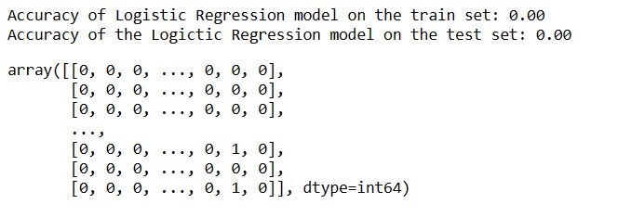
Predictive Modeling using Logistic Regression
Accuracy is 0

Slide 28
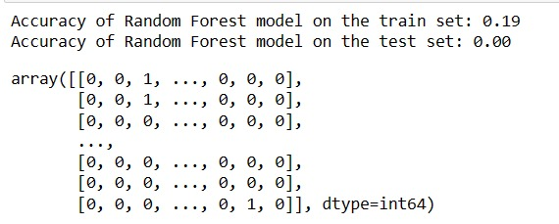
Predictive Modeling using Random Forest
Accuracy is 20% approx – Not impressive

Slide 29
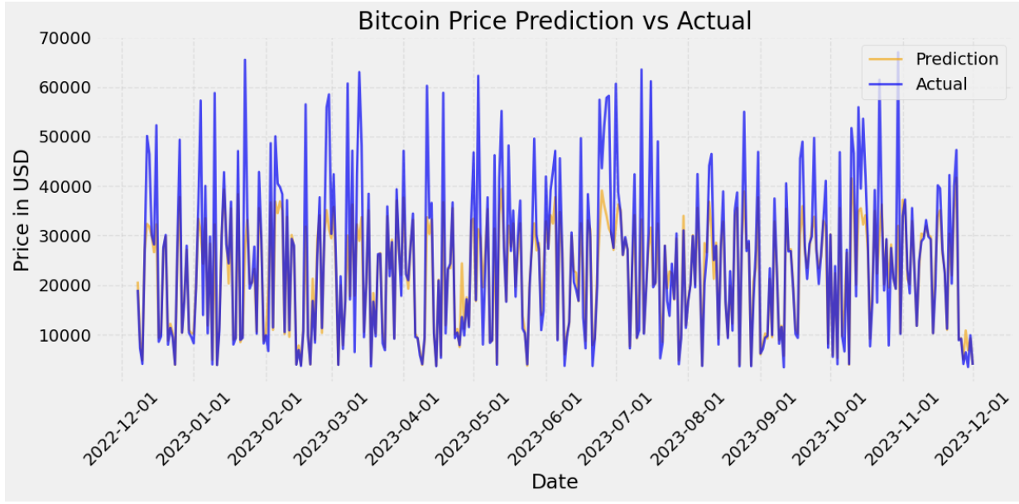
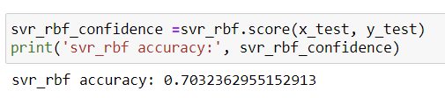
Predictive Modeling using Support Vector Regression
Accuracy = 70%
Better than the other three models

Slide 30
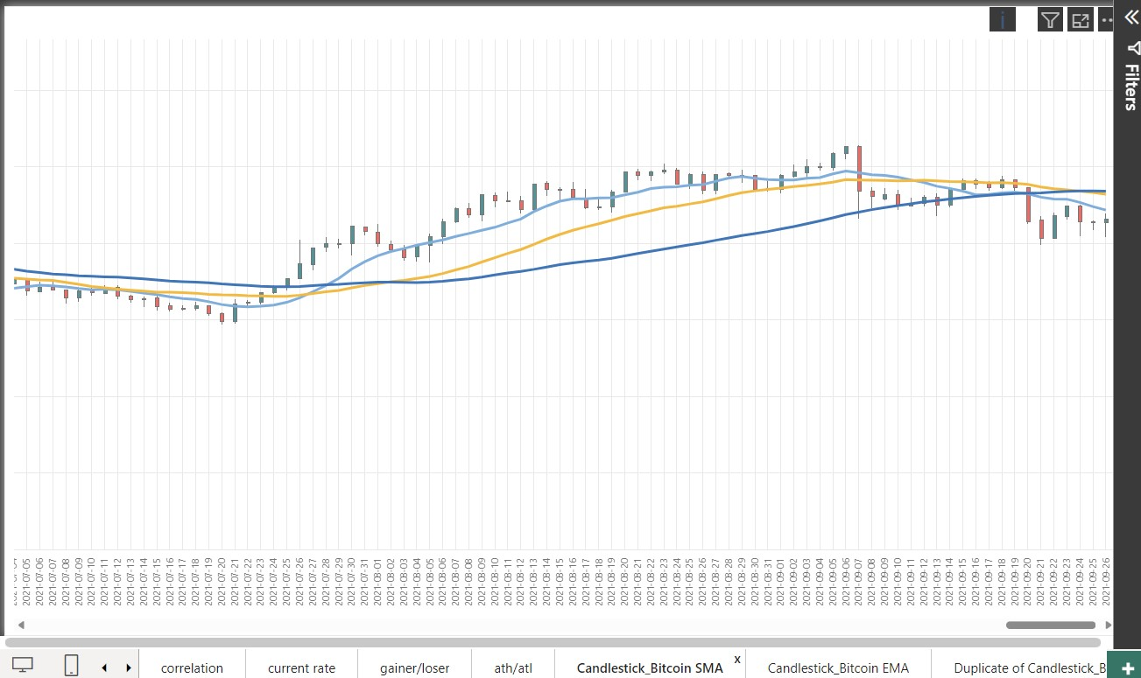
Prediction: Simple Moving Averages

Slide 31
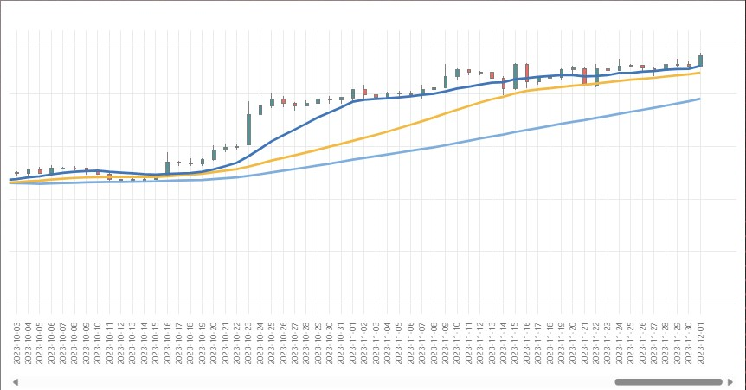
Prediction: Simple Moving Averages

Slide 32
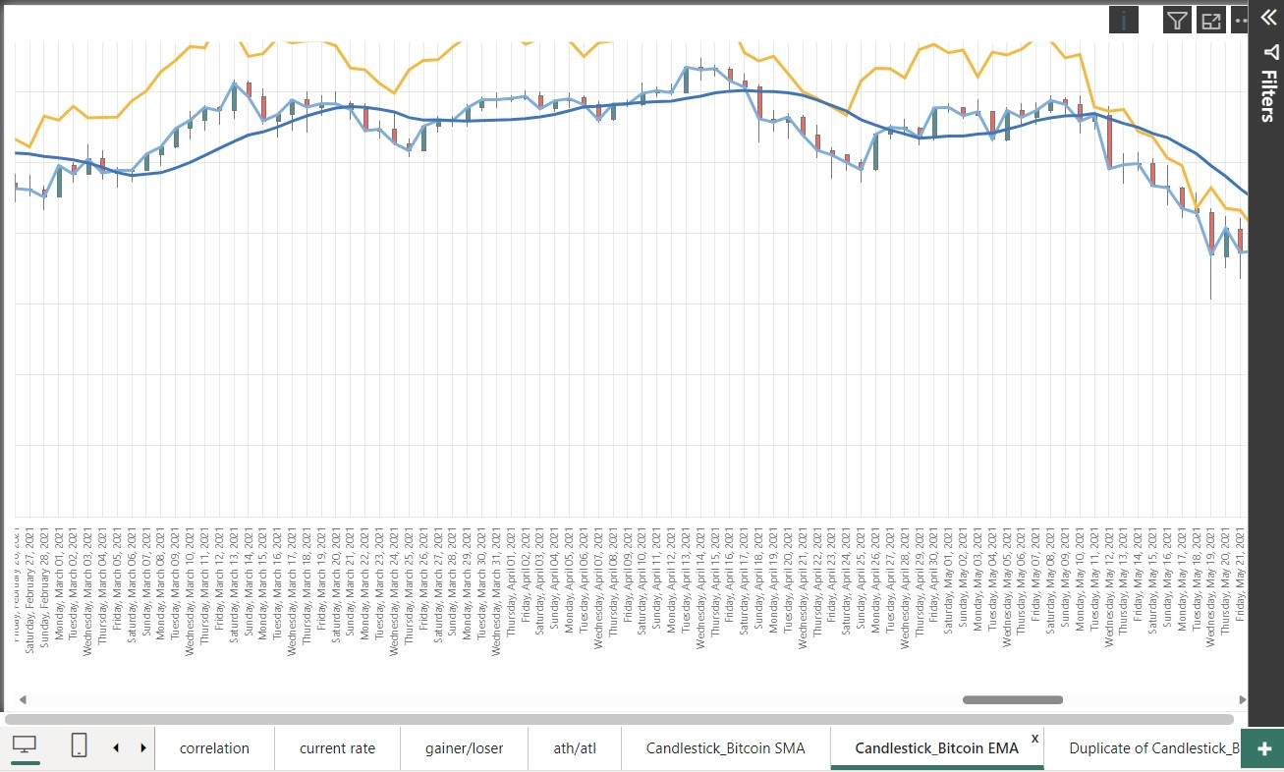
Exponential Moving Average

Slide 33
Conclusion
The visualization shows the growth of cryptocurrency over the years.
Our Prediction Models gives a fairly reliable accuracy in the current market trend.
Disclaimer: Crypto Products are unregulated and can be highly risky. Discussion is only for Information and Education purposes.

